Slide 1
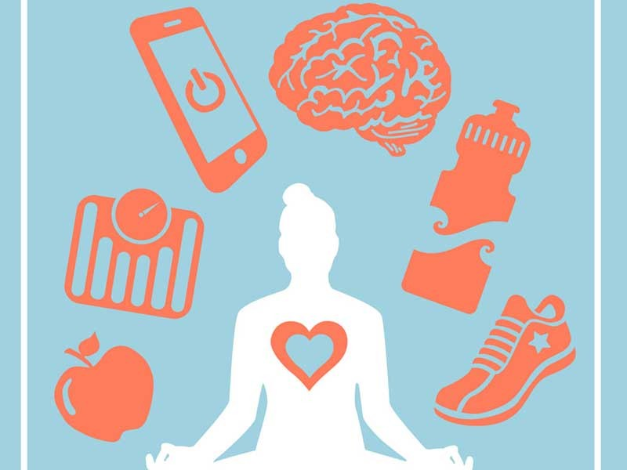
HEALTH IS ONE
MINI project
Members: (UIN)
Srushti S 201P037
Prerna S 201P041
Utsav K 201P049
Mayur K 201P013

Slide 2
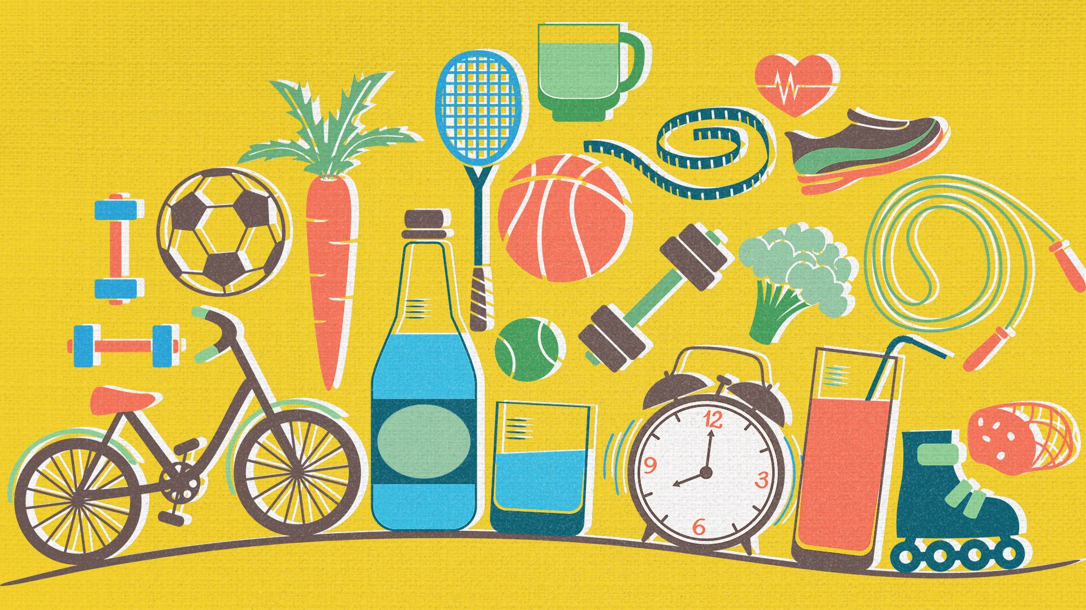
Overview of the project
It is difficult to maintain a healthy lifestyle when we are in the middle of a crisis like this. The uncertainty, and worries related to finances, childcare, elderly parents, and job security disrupt our routines, our lifestyles and mental health.
During these times, developing healthy eating habits, while also regularly carrying out exercise and staying fit is extremely necessary for a strong immune system . These times, when most of us are leading sedentary lives because of COVID19, we tend to take in more calories than are needed, and what happens is that the unused calories accumulate as fat. Along with a proper diet, exercising plays an integral role in controlling your weight by burning extra calories caused by dietary changes and sedentary lifestyles. Meditation is to the mind what physical fitness is to the body. Meditation during these stressful COVID19 times is as important as ever and more and more people are searching for ways to improve this facet of their life.
“Health was earlier said to be the ability of the body functioning well. However, as time evolved, the definition of health also evolved. It cannot be stressed enough that health is the primary thing after which everything else follows. When you maintain good health, everything else falls into place . Similarly, maintaining good health is dependent on a lot of factors. It ranges from the air you breathe to the type of people you choose to spend your time with. Health has a lot of components that carry equal importance. If even one of them is missing, a person cannot be completely healthy.”

Slide 3
First, we have our physical health. This means being fit physically and in the absence of any kind of disease or illness. When you have good physical health, you will have a longer life span. One may maintain their physical health by having a balanced diet. Do not miss out on the essential nutrients; take each of them in appropriate quantities.
Secondly, you must exercise daily. It may be for ten minutes only but never miss it. It will help your body maintain physical fitness. Moreover, do not consume junk food all the time. Do not smoke or drink as it has serious harmful consequences. Lastly, try to take adequate sleep regularly instead of using your phone.
Next, we talk about our mental health. Mental health refers to the psychological and emotional well-being of a person. The mental health of a person impacts their feelings and way of handling situations. We must maintain our mental health by being positive and meditating.
Subsequently, social heath and cognitive health are equally important for the overall well-being of a person. A person can maintain their social health when they effectively communicate well with others. Moreover, when a person us friendly and attends social gatherings, he will definitely have good social health. Similarly, our cognitive health refers to performing mental processes effectively. To do that well, one must always eat healthily and play brain games like Chess, puzzles and more to sharpen the brain.

Slide 4

MIT app inventor
MIT App Inventor (Massachusetts Institute of Technology). is an intuitive, visual programming environment that allows everyone even children to build fully functional apps for smartphones and tablets The MIT App Inventor project seeks to democratize software development by empowering all people, especially young people, to move from technology consumption to technology creation.
MIT App Inventor is a web application integrated development environment originally provided by Google, and now maintained by the Massachusetts Institute of Technology (MIT).

Slide 5
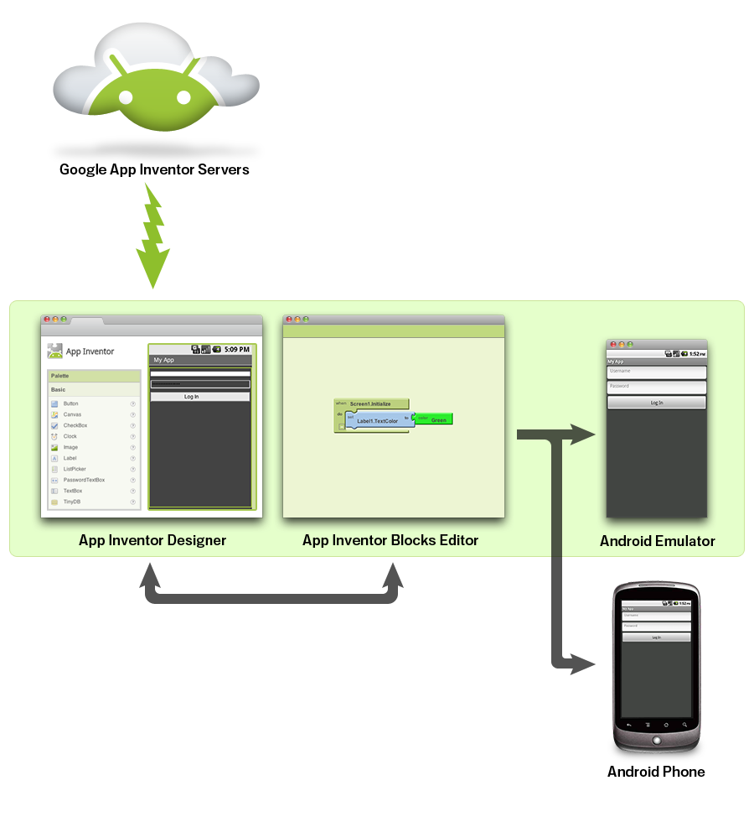
What is App inventor ? How it works? App Inventor lets you develop applications for Android phones using a web browser and either a connected phone or emulator. The App Inventor servers store your work and help you keep track of your projects. .The App Inventor Designer, where you select the components for your app. .The App Inventor Blocks Editor where you assemble program blocks that specify how the components should behave. You assemble programs visually, fitting pieces together like pieces of a puzzle. Your app appears on the phone step-by-step as you add pieces to it, so you can test your work as you build. When you're done, you can package your app and produce a stand-alone application to install.
.If you don't have an Android phone, you can build your apps using the Android emulator, software that runs on your computer and behaves just like the phone.
.The App Inventor development environment is supported for Mac OS X, GNU/Linux, and Windows operating systems, and several popular Android phone models. Applications created with App Inventor can be installed on any Android phone.

Slide 6
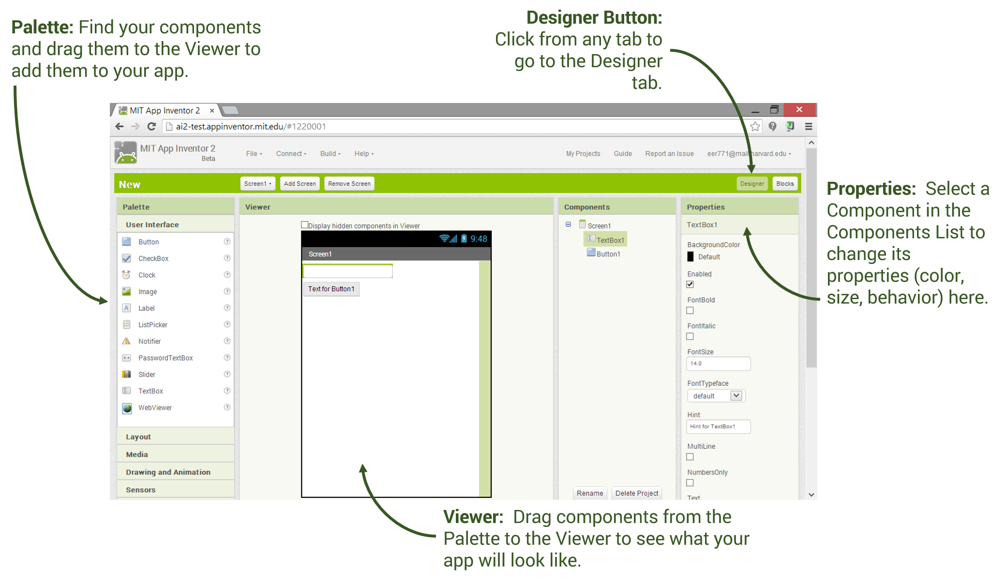
Designer and Blocks Editor
App Inventor Designer
Design the App's User Interface by arranging both on- and off-screen components.

Slide 7
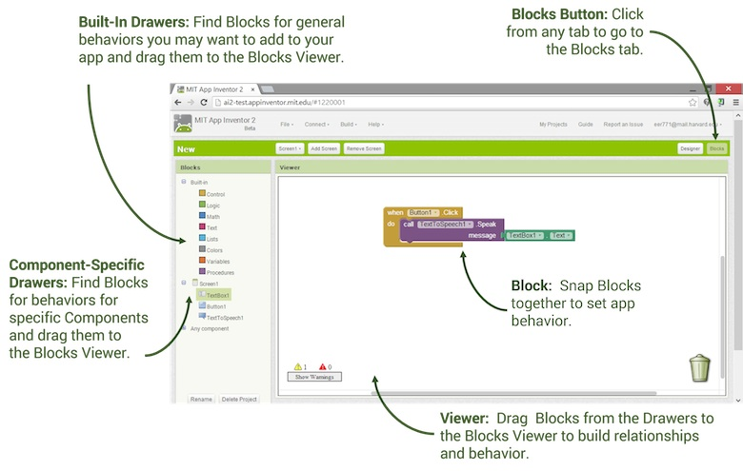
App Inventor Blocks Editor Program the app's behavior by putting blocks together

Slide 8
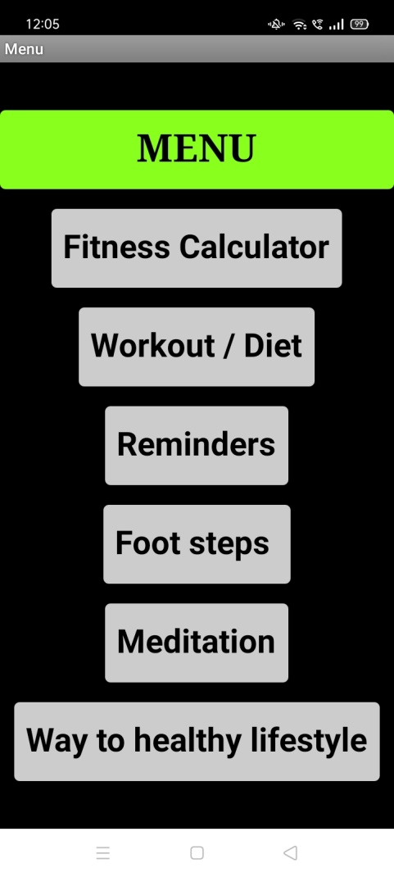
Health is one
So here our first slide of application has a start button, clicking on which will take user to page which has a menu bar in which there are various options for the user like as follows :
Fitness calculator.
Workout/Diet.
Water reminder.
Medication reminder.
Footsteps counter.
Meditation.
Way to healthy lifestyle.

Slide 9
Advantages
This app will help you maintain a healthy lifestyle
From maintaining your weight to diet provides you all information that is necessary
Tracks and helps you while walking or meditation
Gives you tips that can be added in your daily routine
Be a perfect assistant to your gym work from starch like body weight training and building strength till building muscles
With following this app rightly you will build a better version of your self a healthy and systematic person and this will keep you away from mental stress and other disturbances caused by unhealthy lifestyle

Slide 10
Drawbacks
The work is sufficient to provide guidelines for health app requirements, the study is not without its limitations. For instance, the number of papers that are relevant to this study‟s context is small which limits the ability to generalise our findings. Further, our review was widened to include different health areas and diseases but future research may focus solely on one area. However, this limitation offered an opportunity for our research as providers have yet to fully address the health app requirements for mobile phones. In this regard, our work can help the providers to focus their attention on the key features and content of health apps.

Slide 11

As the analysis and examples in this report have demonstrated, a wide array of factors influences a community's health, and many entities in the community share responsibility for maintaining and improving its health.
Contributing to the interest in health improvement and performance monitoring is a wider recognition that health embraces well-being as well as the absence of illness. For both individuals and populations, health can be seen to depend not only on medical care but also on other factors including individual behaviour regarding diet and daily exercise and social and economic conditions.
Our workout and diet module guides individual to improve their health and fitness with planned diet and provide one month workout plan.
Meditation module of our project helps one to maintain mental health which was hit had in last few days due to pandemic and lockdown.
A healthy walk, timely medication, and proper care of body helps one to maintain a healthy lifestyle.
“Personal health is a vital function that requires broad personal concern and support in order to fulfill society's interest in assuring the conditions in which people can be healthy.” Organized community effort to prevent disease and promote health is both valuable and effective.

Slide 12
Literature Survey
1) A Design of Mobile Health for Android Applications
In this paper, a mobile health application is developed to recommend healthcare support referring to exercise in the Android Smart phone. This application has been designed to provide exercise advice depending on Body Mass Index (BMI) and the energy used in each activity or sport. Moreover, it has been designed to store information in a database and to have the ability to produce to users.
‘Mobile Health’ can combine health and mobile device technology, especially smart phones. It can be defined as ‘medical and public health practice supported by mobile device.
The proposed android architectural framework and module development encompasses four modules as follows:
1) Food Calorie intake Calculator module:
This module computes the customized menu choice and offers suggestions for other menu options to achieve the goal of either losing weight or eating healthy foods.
2) BMI Calculator:
This module calculates the Body Mass Index (BMI) of the user based on the height and weight, using the formula BMI = Weight (kg)/ (Height (m))2 . The essence of this module is to generate useful information regarding the BMI parameter used for ascertaining a person’s of getting health related issues.
3) Disease Risk Determinator Module:
Based on the computation of the BMI and the user specifications of the nature of work, exercise routine and other factors, the Disease Risk Determinator module then determines users risk profile and tracks it while offering excellent Meal time Planner to get back into shape and avoid unnecessary hospital visits due to poor healthy lifestyle.
4) Meal Time Planner: This module presents to the user the various meal plans for breakfast, lunch, and dinner based on the amount of calories needed by the person taking into consideration, age, type and nature of work, several favorite dishes for breakfast, lunch and dinner. It has one Exercise related index, to evaluate and indicate the change of body after performing exercise. There are few indexes that considered: 1) Body Mass Index (BMI) 2) Basal Metabolic Rate (BMR) 3) Metabolic Equivalent of Task

Slide 13
There are few indexes that considered: 1) Body Mass Index (BMI) 2) Basal Metabolic Rate (BMR) 3) Metabolic Equivalent of Task Further, the application developer has made a facility for the users to consult doctors through application, for having safe exercise plan and health related issues. The developer had system components like web application that enables information via web, databases server which stores information related to meal, web service, android applications. Limitations: Firstly this app is designed in the most basic way so that every age people from different countries and continents can use it easily , so it doesn’t consist of high display graphics anywhere present in the app . This app doesn’t support IOS (Iphone operating system). Conclusion: This paper presented necessary guidance and health recommendations for mobile users who have installed the android applications. The proposed system model generates food tips and recommendations for different categories of people who are underweight, overweight or obese due to a computation of their body mass indices. It specifies certain exercise regimen types that are appropriate for these different kinds of people. Further expansion to allow for versatility and ubiquity is to implement the Personal Health Monitor app on other mobile platforms apart from android. This design of a Health is One mobile health application called “Home workout on the Android Operating System‟ has been added. It has been designed to recommend exercise for each individual who has different physical characteristics (e.g. weight and height). Therefore, he or she can exercise appropriately, not too less or too much, with different kinds of workouts that he or she selects. Also, several functions have been included (e.g. calculation of BMI, footstep calculator, water reminder and many more). Furthermore, this mobile Health application has been also designed to be able to use easily irrespective of any age. Overcome on Limitations: We have developed an application referring to the features used in the above project. Also we tried to add some extra features like water reminder, footsteps counter, etc. ‘Health is One’ can be accessed through any operating system i.e., android or iOS. Also, this application does not consume much space in device. There are further plans to add some more features like Consultation with doctors directly from home 24/7, online gym trainers, online dietician, etc

Slide 14
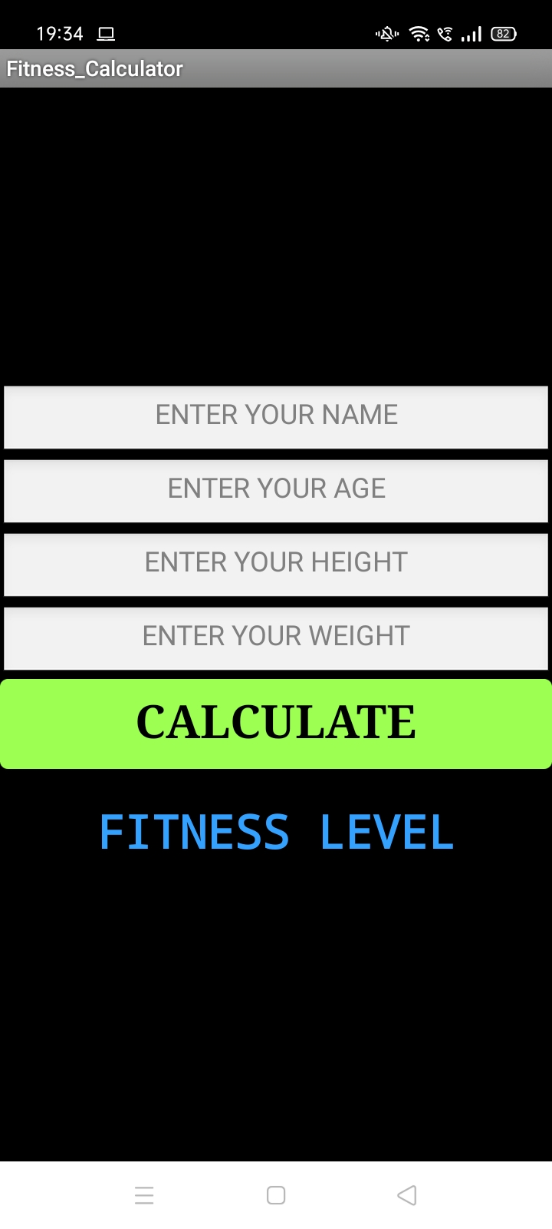
Fitness calculator
The feature in our application will calculate the user’s fitness level using his/her height and weight, the same way as BMI (Body Mass Index) is normally being calculated.
It asks the user to enter their name, age, height and weight in the format as follows: Enter Your Name
Enter Your Age
Enter Your Height
Enter Your Weight
Calculate
Fitness Category
After entering required details the application feature will calculate the fitness level using the formula as:
Fitness = Weight (in kg) / Height ^2 (in cms)
Once the calculation process is done, the user will get to know in which category do he/she falls into, i.e. Under weighted, Normal weighted, Over weighted or Obese.
A text to speech is being added to this feature, when the user gets to know the category he/she is falling into, an audio will be played according to the category as :
When the fitness calculator displays you fall in Under Weight category, the fitness calculator feature tells you: “You are Under Weighted, eat frequently and stay healthy!”
When the fitness calculator displays you fall in Normal Weighted category, the fitness calculator feature tells you: “You are Normal Weighted, continue with the same diet and stay fit!”
When the fitness calculator displays you fall in Over Weighted category, the fitness calculator feature tells you: “You are Over Weighted, Follow the diet provided and stay fit!”
When the fitness calculator displays you fall in Obese category, the fitness calculator feature tells you: “Change your eating habits, Eat more healthy, stay fit!”
Now according to their category the user will be asked to visit the page where he/she will be provided with a proper diet and workout plan. This feature is based on the button 2 in the above options i.e. Workout/Diet.

Slide 15
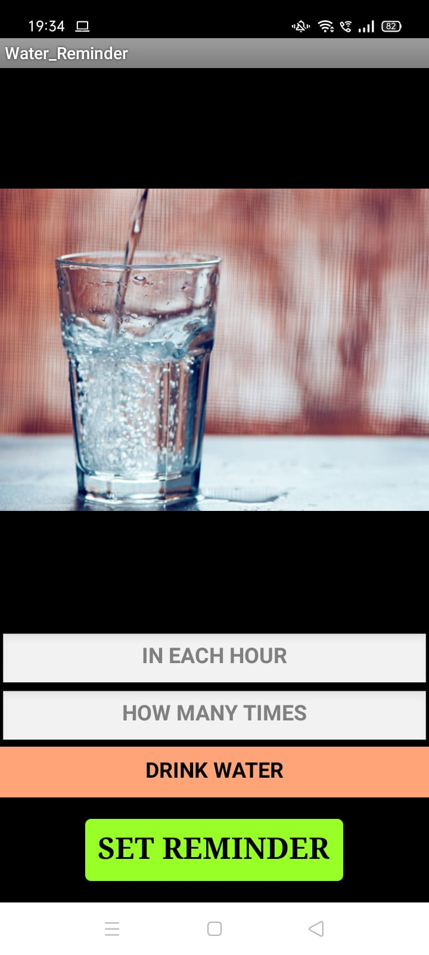
Water reminder
The feature in our application will be reminding the user to drink water in the chosen time span by them. The feature will first ask the user in how many hours does him /her wants to drink water. Then it will ask how many times do the user wants to drink water in a day. According to the information provided by user a ‘drink water’ named default alarm will be setup into the users device. As the alarm will ring the user will be asked to drink water.
In Each Hour
How Many Times
Drink Water
Set Reminder

Slide 16
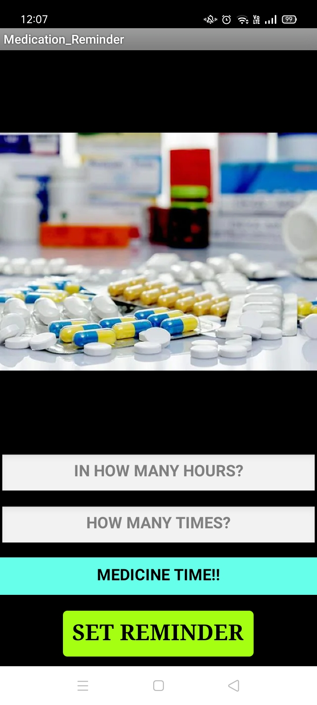
Medication Reminder
The feature in our application will be reminding the user to take their medicines in the chosen time span by them. The feature will first ask the user in how many hours does him /her wants to take the medicines. Then it will ask how many times does the user want to take their medicines in a day. According to the information provided by user a ‘Take your medicines’ named default alarm will be setup into the users device. As the alarm will ring the user will be asked to take their medicines.
In Each Hour
How Many Times
Medicine time
Set Reminder

Slide 17

Meditation
This meditation feature in application will help the user to increase the concentrating power. Whenever the user will require to relax, he/she can just use this feature.
Start
Stop
Once the will click on the start button provided on meditation page, a soft tune of few seconds will start in the background. This will help to increase the concentrating power. The user can stop the tune by clicking the stop button.

Slide 18
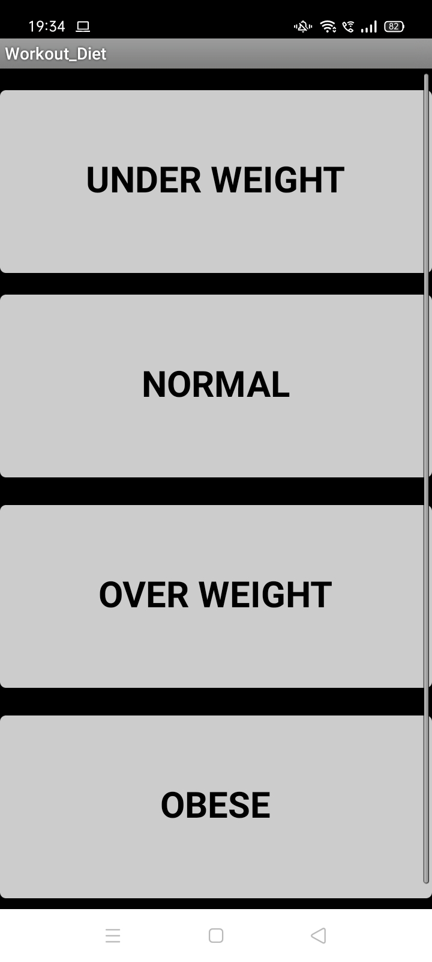
Workout and Diet
The feature in our application will be suggesting a good one month workout along with diet plan to the user according to their fitness categories. When the user gets to know the category that they fall into will then be asked to click the button 2 i.e. Workout/Diet. Clicking on Workout/Diet button will take user to the page where all fitness categories are listed as buttons. Clicking on any of the button will take the user to the page having two buttons of Workout and Diet which again clicking will get to their respective pages. Here the workout screen again has two options i.e. Home workout and Gym. So when the user clicks on any of the buttons according of their choice, different images will seen and steps with some information based on the particular exercise i.e. what part of the body will be developed doing that exercise will be displayed. Similarly, in the diet section the user will be advised with some immunity building fruits, veggies, pulses, etc. which should be included in their regular diet.

Slide 19

Footsteps counter
This feature in the application will be detecting the number of foot steps taken by the user. This feature can be used by the user while going for morning/evening walks. This feature starts working as soon as the user will click on the start button.
Counter
Start
Stop
Reset
Once the user clicks on the start button and start moving, the counter will start counting the steps taken. The user can also stop the counter just by clicking the stop button.
He/she can also resume the walk from the last count by clicking on the start button or can restart the count by clicking the reset button. Reset button will set the counter to zero value again.

Slide 20
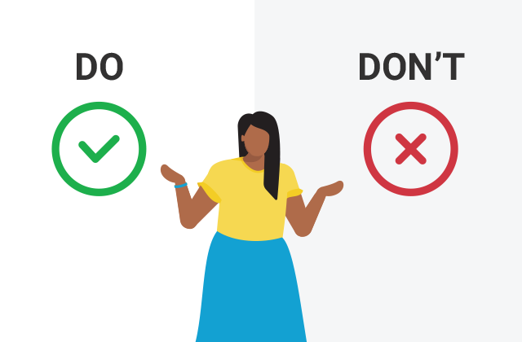
Immune system Do’s and Don’ts
In this section the main focus would be giving some short tips that can be added in day to day life and some mythbuster regarding some things which are feeded wrong in our mind it basically has two columns i.e do’s and don’ts where some things are provided that should be done for a healthy life style , diet, protein intake and gym regarding things. And in don’ts there are things which can be harmful to your diet and may cause some problem in future some habits that are not good to your lifestyle for eg.
DO’S | DON’TS
Eat a rainbow of fruits and vegetables of various colors as part of a balanced diet. Make sure you’re consuming enough calories. Maintain a regular sleep schedule. Get at least 150 minutes of moderate exercise a week, if it’s been deemed safe. TAKE PROBIOTICS TAKE CARE OF YOUR NERVOUS SYSTEM Exercise regularly Eat right and consume enough calories with the proper amount of protein | Go out in public unless absolutely necessary. Smoke or use any tobacco product. Fall for supplement claims that overstate specific health benefits. CONSUME SUGAR LET STRESS GET YOU DOWN Avoid working from the office if you’re sick

